Slide 1


Health Economics Lecture #3
Topic: The (Simplified) Grossman Model
Prepared by Jacob Smith, Trent University

Slide 2
Learning Objectives
In this lecture, we will discuss:
The Big Picture: The Demand for Health
How consumers make choices: Indifference Curves and Budget Constraints.
The Production of Health: Health Inputs and Health Outputs.
Trade-offs between Investing in Health and Consumption
Comparative Statics/Sensitivity Analysis with the Grossman Model
Goal of this Lecture:
Introduce the Grossman Model.
Show how it can be used to assess health different health policies.

Slide 3
The Big Picture: The Demand for Health

Slide 4
How Economists Think About Health
Economics is a field that emphasises individual choice as the primary determinant of individual outcomes.
This is the same way economists think about the determination of health status.
As a gross simplification we will assume moving forward that health status is determined by: 1) Individual Choice. 2) Genetic Endowment.
In particular, we are interested in defining a model which explains two facts:
Fact 1: Wealthier people live longer on average.
Fact 2: Educated People live longer on average

Slide 5
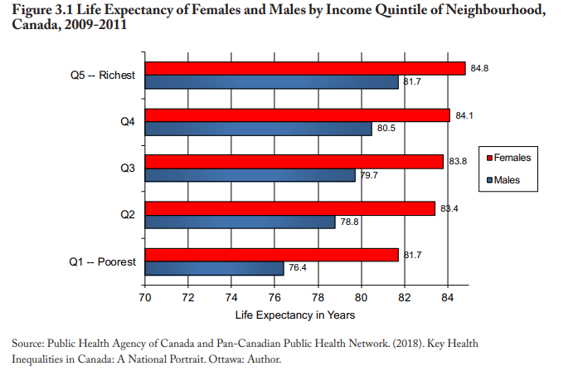
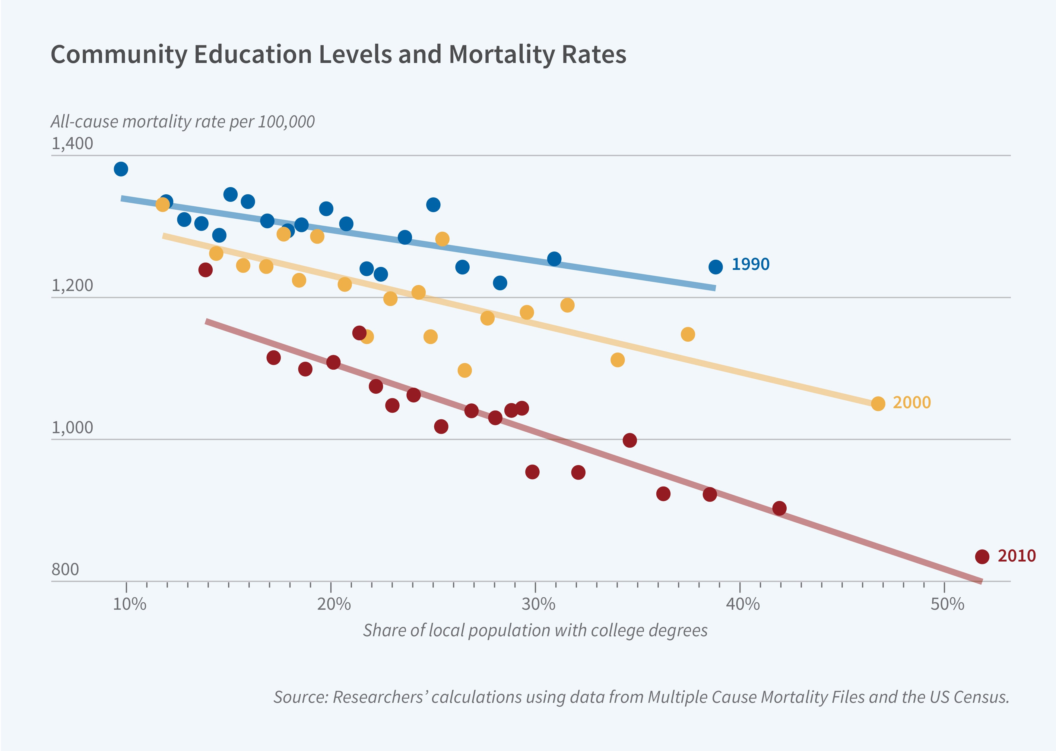
Two Important Empirical Facts
(A) Wealthier People Live Longer on Average
(B) “Educated People Live Longer on Average” Source: https://www.nber.org/bh/20242/why-do-more-educated-communities-have-better-health-outcomes

Slide 6
How Economists Think About Health
The Goal: “Define a model which explains these facts about Wealth, Education and Life Expectancy and use it to make assessments of different health policies”
In particular the model should be useful for making an assessment of: 1) How changes in the price of healthcare/access to insurance impact individual investment in health. 2) How negative/positive changes in income impact individual health outcomes. 3) How the price of other goods can impact health outcomes. 4)How improvements to medical technology/access impacts health outcomes.

Slide 7


Two People To Thank
Michael Grossman Formalized how economists think about investment in health
Adam Wagstaff Simplified the model proposed by Michael Grossman and made it accessible to policy makers.

Slide 8
How consumers make choices: Indifference Curves and Budget Constraints.
Part 1: The Budget Constraint

Slide 9
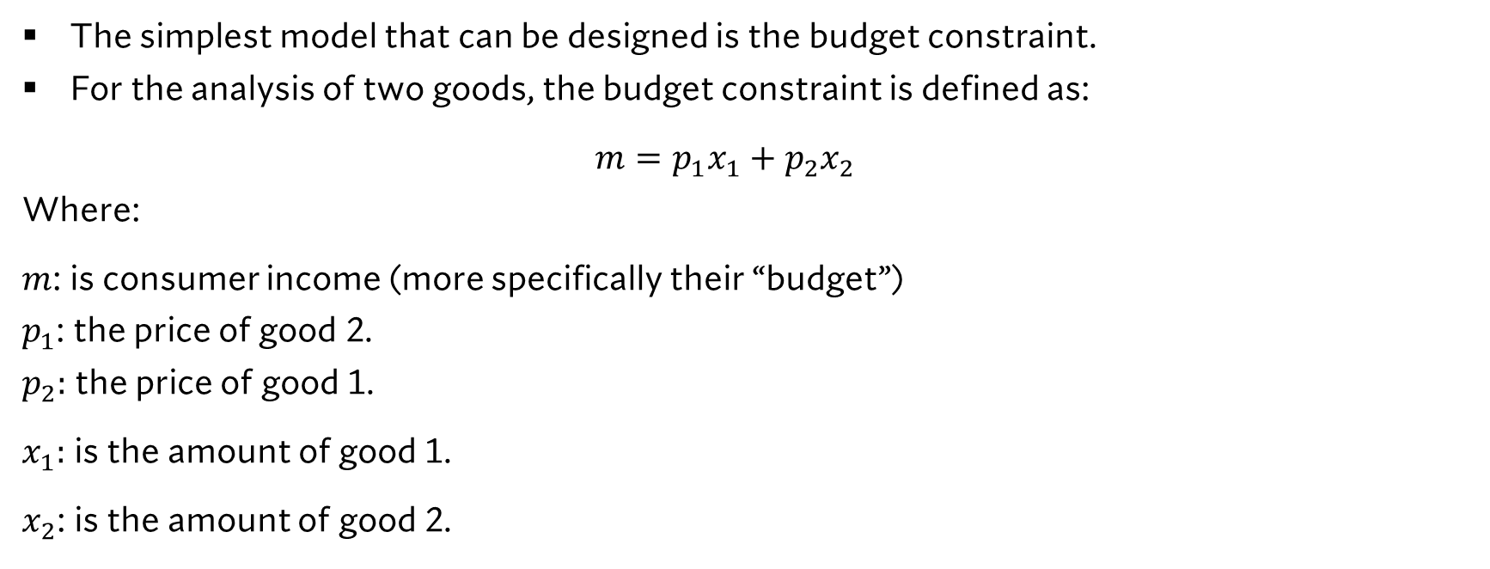
An Introduction to the Budget Constraint
The simplest model that can be designed is the budget constraint.
For the analysis of two goods, the budget constraint is defined as: $m=p_{1}x_{1}+p_{2}x_{2}$
Where: $m$: is consumer income (more specifically their “budget”)
$p_{1}$: the price of good 2.
$p_{2}:$ the price of good 1. $x_{1}:$ is the amount of good 1. $x_{2}$: is the amount of good 2.

Slide 10
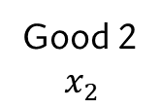
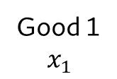
An Introduction to the Budget Constraint
Graphically, we can represent the budget constraint in the diagram on the left.
Good 2 $$x_{2}$$
0
Good 1 $$x_{1}$$

Slide 11
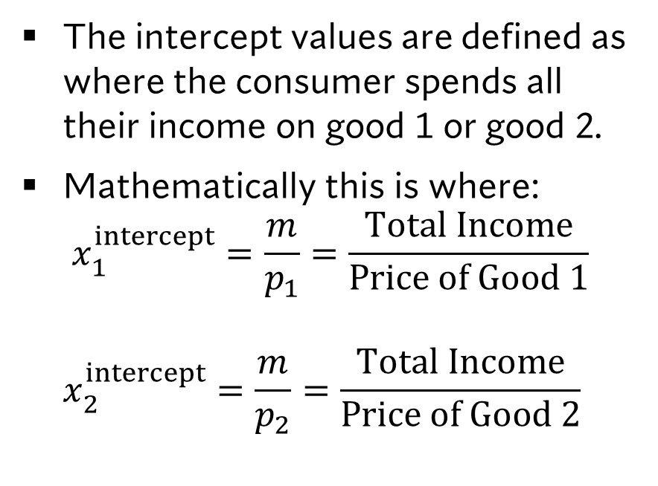


An Introduction to the Budget Constraint
The intercept values are defined as where the consumer spends all their income on good 1 or good 2.
Mathematically this is where: $x_{1}^{intercept}=\frac{m}{p_{1}}=\frac{Total Income}{Price of Good 1}$ $x_{2}^{intercept}=\frac{m}{p_{2}}=\frac{Total Income}{Price of Good 2}$
Good 2 $$x_{2}$$
$$x_{2}=\frac{m}{p_{2}}$$
$$x_{1}=\frac{m}{p_{1}}$$
0
Good 1 $$x_{1}$$

Slide 12
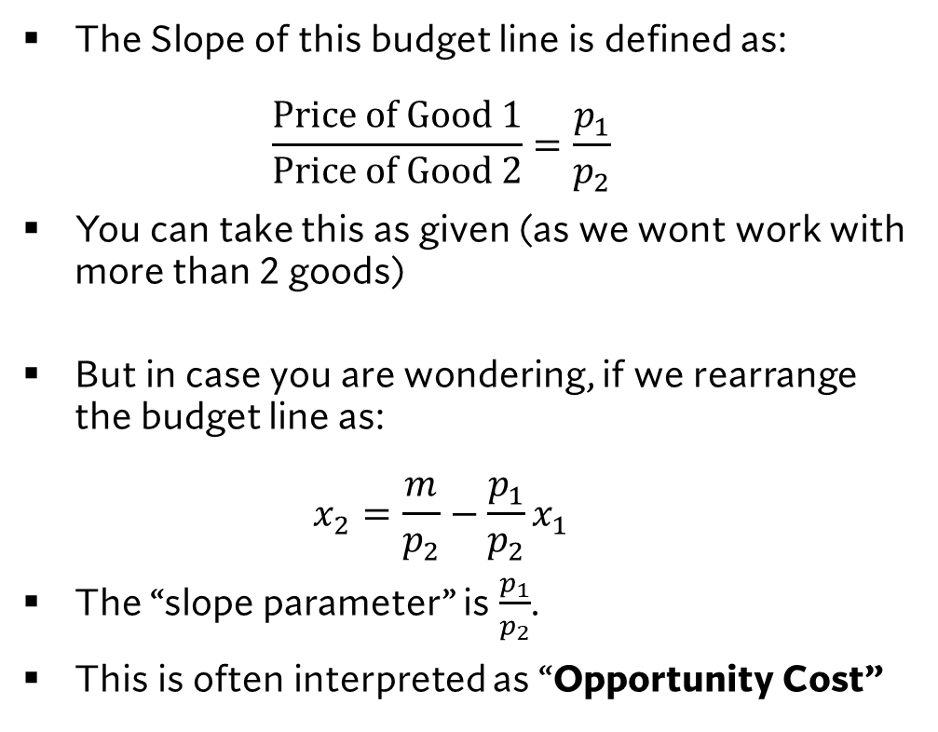

An Introduction to the Budget Constraint
The Slope of this budget line is defined as: $\frac{Price of Good 1}{Price of Good 2}=\frac{p_{1}}{p_{2}}$
You can take this as given (as we wont work with more than 2 goods)
But in case you are wondering, if we rearrange the budget line as: $x_{2}=\frac{m}{p_{2}}−\frac{p_{1}}{p_{2}}x_{1}$
The “slope parameter” is $\frac{p_{1}}{p_{2}}$.
This is often interpreted as “Opportunity Cost”
Good 2 $$x_{2}$$
$$\frac{p_{1}}{p_{2}}$$
0
Good 1 $$x_{1}$$

Slide 13
An Introduction to the Budget Constraint
Everything on and below the budget line is feasible (affordable).
Everything outside of the budget line is unfeasible (unaffordable).
Good 2 $$x_{2}$$
Unfeasible Region (Unaffordable)
Feasible Region (affordable)
0
Good 1 $$x_{1}$$

Slide 14

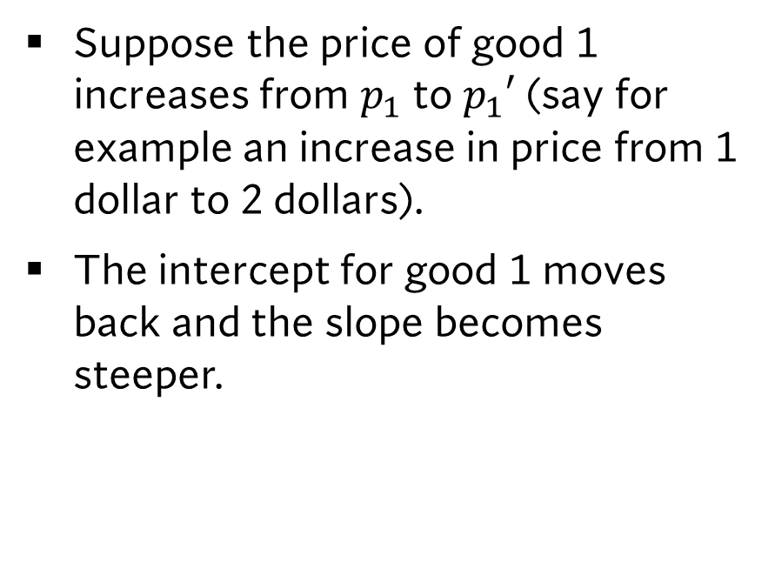


The Effect of a Increase in Price of Good 1
Suppose the price of good 1 increases from $p_{1}$ to $p_{1}′$ (say for example an increase in price from 1 dollar to 2 dollars).
The intercept for good 1 moves back and the slope becomes steeper.
Good 2 $$x_{2}$$
$$\frac{m}{p_{2}}$$
0
$$\frac{m}{p_{1}^{′}}$$
$$\frac{m}{p_{1}}$$
Good 1 $$x_{1}$$

Slide 15

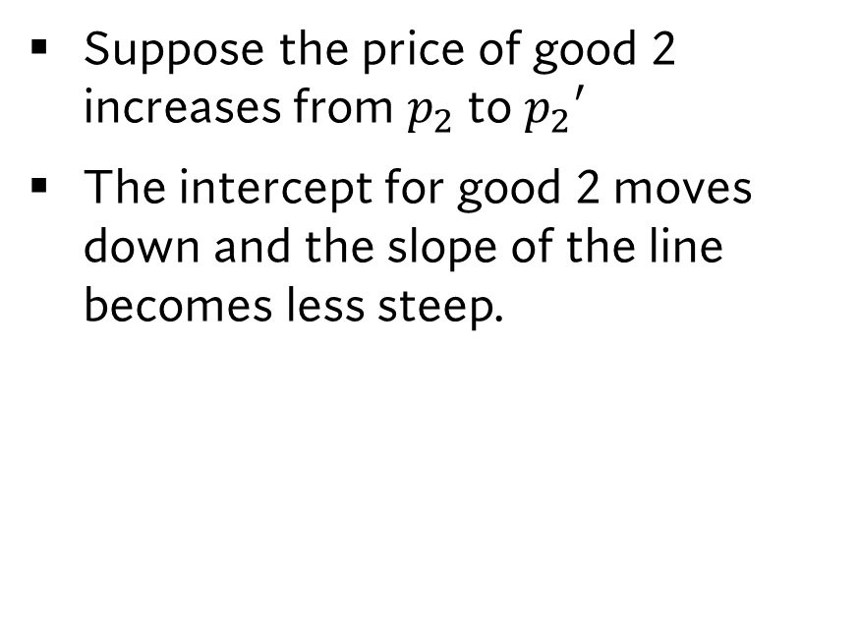
The Effect of a Increase in Price of Good 2
Suppose the price of good 2 increases from $p_{2}$ to $p_{2}′$
The intercept for good 2 moves down and the slope of the line becomes less steep.
Good 2 $$x_{2}$$
$$\frac{m}{p_{2}}$$
$$\frac{m}{p_{2}^{′}}$$
0
$$\frac{m}{p_{1}}$$
Good 1 $$x_{1}$$

Slide 16


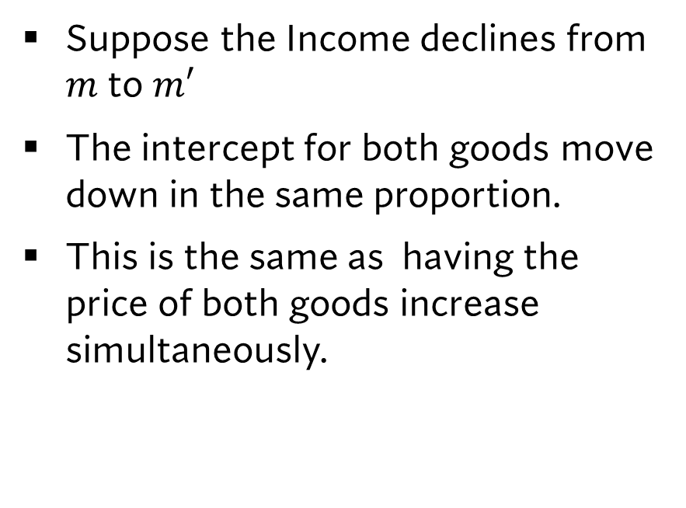
The Effect of a Decline in Income
Suppose the Income declines from $m$to $m′$
The intercept for both goods move down in the same proportion.
This is the same as having the price of both goods increase simultaneously.
Good 2 $$x_{2}$$
$$\frac{m}{p_{2}}$$
$$\frac{m′}{p_{2}}$$
0
$$\frac{m′}{p_{1}}$$
$$\frac{m}{p_{1}}$$
Good 1 $$x_{1}$$

Slide 17
Things for you to think about.
What happens when the price of good 1 or good 2 decreases?
What happens when income increases?
Good 2 $$x_{2}$$
0
Good 1 $$x_{1}$$

Slide 18
How we use the Budget Constraint
We will be looking at two goods.
HEALTH INPUTS and CONSUMPTION
This is our “good 1” and “good 2”
CONSUMPTION
0
HEALTH INPUTS

Slide 19
How consumers make choices: Indifference Curves and Budget Constraints.
Part 2: Indifference curves

Slide 20
An Introduction to Indifference Curves
Good 2 $$x_{2}$$
We want to analyze individual preferences over combinations of good 1 and good 2.
The Indifference Curve is used to show the combinations of goods where individuals are indifferent
An Indifference Curve
0
Good 1 $$x_{1}$$

Slide 21
An Introduction to Indifference Curves
Good 2 $$x_{2}$$
As an example, this curve shows that an individual is indifferent between consuming: 2 units of Good 1 and 5 units of good 2 and 6 units of good 1 and 2 units of good 2.
(2,5)
(6,2)
An Indifference Curve
0
Good 1 $$x_{1}$$

Slide 22



An Introduction to Indifference Curves
Good 2 $$x_{2}$$
Indifference curves will be used to indicate different levels of individual utility or satisfaction.
A major assumption about indifference curves is that THEY CAN NEVER CROSS.
This is because they show bundles that have different levels of satisfaction, and one bundle cannot have two different levels of satisfaction.
Utility Level 3 $U_{3}$
Utility Level 2 $U_{2}$
Utility Level 1 $U_{1}$
0
Good 1 $$x_{1}$$

Slide 23

An Introduction to Indifference Curves
Good 2 $$x_{2}$$
In general the higher level of Utility will be denoted by the higher indifference curve.
I.e. $U_{3}>U_{2}>U_{1}$
So Curve $U_{3}$ is the highest level of satisfaction or happiness followed by $U_{2}$ and $U_{1}$.
Utility Level 3 $U_{3}$
Utility Level 2 $U_{2}$
Utility Level 1 $U_{1}$
0
Good 1 $$x_{1}$$

Slide 24
The Budget Constraint and Indifference Curves Together
Good 2 $$x_{2}$$
We can the way individuals choose between good 1 and good 2 as a result of the following behaviour.
Individuals seek the highest level of utility but are constrained by their budget. Because of the constraint, individuals direct themselves to unique outcomes.
0
Good 1 $$x_{1}$$

Slide 25
The Budget Constraint and Indifference Curves Together
Good 2 $$x_{2}$$
The budget constraint and indifference curve together says a lot about how economists think about the world.
People have different allocations of goods because of differences in: 1) Their Budget. 2) Their Preferences.
An Indifference Curve
0
Good 1 $$x_{1}$$

Slide 26
How consumers make choices: Indifference Curves and Budget Constraints.
Part 3: Justifying 2 goods models- The Composite Commodity Theorem

Slide 27
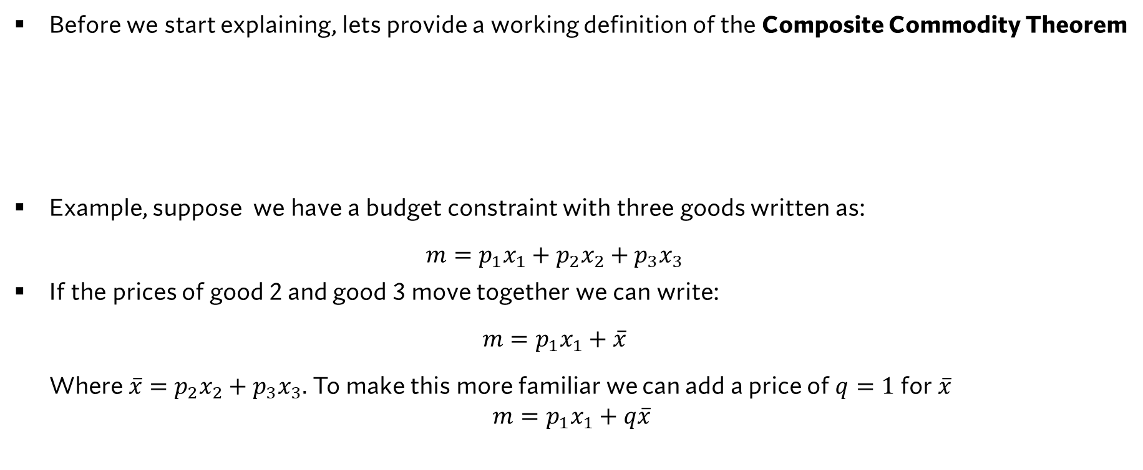
The Composite Commodity Theorem: The Statement
Before we start explaining, lets provide a working definition of the Composite Commodity Theorem
Example, suppose we have a budget constraint with three goods written as: $m=p_{1}x_{1}+p_{2}x_{2}+p_{3}x_{3}$
If the prices of good 2 and good 3 move together we can write: $m=p_{1}x_{1}+\overline{x}$ Where $\overline{x}=p_{2}x_{2}+p_{3}x_{3}.$ To make this more familiar we can add a price of $q=1$ for $\overline{x}$
$$m=p_{1}x_{1}+q\overline{x}$$
THE COMPOSITE COMMODITY THEOREM
If two or more goods prices move in the same proportion then the goods values may be aggregated (summed together) as a Composite Commodity.

Slide 28
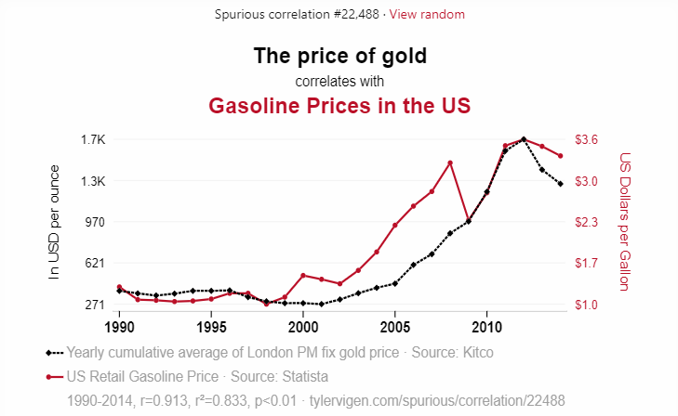
The Composite Commodity Theorem: What You Need to Know
The composite commodity theorem allows economists to aggregate goods based on price movements alone and is purely on a correlation basis.
Used on its own, we can justify lots of different indexes.
But that does not mean it makes sense.
When creating an index we need to think if it makes sense in our context.

Slide 29
The Production of Health: Health Inputs and Health Outputs.

Slide 30

Modelling the Production of Health
Health Outputs
We assume that health is a Derived Good.
This means that individuals do not purchase health directly but invest in inputs to subsequently produce it using a HEALTH PRODUCTION FUNCTION.
The graph of this function is shown on the left.
$$H(I)$$
0
Health Inputs

Slide 31
Modelling the Production of Health
Health Outputs
An assumption made about the production of health is that it has Diminishing Returns to Scale.
That means that while investment in health inputs increase health outputs, it does so in a diminishing fashion.
I.e the first unit of health investment will add more to health compared to the second unit and so on.
$$H(I)$$
0
Health Inputs

Slide 32


Modelling the Production of Health
Health Outputs
We can think of people with a poor genetic endowment or less information about health status as having a less efficient health production.
Graphically we can see that if we have two individuals 1 and 2. Individual 2 has a less efficient production
$$H_{1}(I)$$
$$H_{2}(I)$$
0
Health Inputs

Slide 33
Modelling the Production of Health: Something to Think About
Health Outputs
How does an improvement in medical care impact the health production function?
$$H(I)$$
0
Health Inputs

Slide 34
Trade-offs between Investing in Health and Consumption

Slide 35
Health and Consumption Possibilities Curve
The budget constraint modelled the tradeoffs between spending on health inputs and consumption.
The Health and Consumption Possibilities Curve shows the trade off between health and consumption directly.
The curve is curved because of the diminishing returns in the production of health.
Health
Consumption

Slide 36
Health and Consumption Possibilities Curve
Every point under the curve is defined as Feasible while every point outside of the curve is defined as Unfeasible
Health
Unfeasible Region
Feasible Region
Consumption

Slide 37
Health and Consumption Possibilities Curve
The determination of health outcomes in this graph can be thought of as a result of a direct choice between consumption and health.
Health
Consumption

Slide 38
Health and Consumption Possibilities Curve
Improvements in health productivity will shift the health intercept upwards.
Health
Consumption

Slide 39
Health and Consumption Possibilities Curve
A decrease in the price of consumption will shift the curve right and outwards.
Health
Consumption

Slide 40
Health and Consumption Possibilities Curve: Some things to think about
Does a change in the price of a medical services impact the health and consumption possibilities curve?
Health
Consumption

Slide 41
Comparative Statics/Sensitivity Analysis with the Grossman Model

Slide 42
Objectives for this section
We are going to put all three pieces of the Grossman model together.
The Budget Constraint.
The Health Production Function.
The Health and Consumption Possibilities Curve.
With addition of a “helper quadrant” we will see that its possible to make assessments of changes in outcomes across all sectors directly

Slide 43
Equilibrium in the Grossman Model
Health
Health Inputs
Consumption
Consumption

Slide 44
Equilibrium in the Grossman Model
Health
For now, we will assume people choose their health directly, as seen with the Indifference curve in this quadrant.
Health Inputs
Consumption
Consumption

Slide 45
Equilibrium in the Grossman Model
Health
Limits on the maximum amount of health and consumption that can be consumed is given by the Red stars.
Health Inputs
Consumption
Consumption

Slide 46
Scenario #1: A decrease in the Price of Health Inputs
Health
Draw how Equilibrium Changes!
Health Inputs
Consumption
Consumption

Slide 47
Scenario #2: Public Health Awareness About Handwashing and Health
Health
Draw how Equilibrium Changes!
Health Inputs
Consumption
Consumption

Slide 48
Scenario #3: Increase in Income
Health
Draw how Equilibrium Changes!
Health Inputs
Consumption
Consumption

Slide 49
Applying this model to your group presentations
You will have a paper which may require you to use either: 1) The Grossman Model (Explained Here). 2) The Rational Addiction Model (Explained Next Week).
You must choose which one to appropriately apply for your assigned paper.
Regardless of which model you choose, I expect you to draw the 4-quadrant diagram and show what has happened.
As you see, you can use this model to assess different health policies graphically (without much mathematics!).

Slide 50
Learning Objectives
In this lecture, we will discuss:
The Big Picture: The Demand for Health
How consumers make choices: Indifference Curves and Budget Constraints.
The Production of Health: Health Inputs and Health Outputs.
Trade-offs between Investing in Health and Consumption
Comparative Statics/Sensitivity Analysis with the Grossman Model
Goal of this Lecture:
Introduce the Grossman Model.
Show how it can be used to assess health different health policies.

Slide 51
HIDDEN SLIDES FOR CLASS

Slide 52

A Warning About the Next Slides
The next couple of slides will show the whole model.
It may be difficult to understand so here’s my advice:
For this section, try to look at the model as if you are at an art gallery.
Appreciate the picture for now with the expectation of learning the rest of the story in later slides.

Slide 53
Where we are headed: The “Simplified” Grossman Model
Health
Health Inputs
Consumption
Consumption

Slide 54
Where we are headed: The “Simplified” Grossman Model
Health
Health Production Function
Health and Consumption Possibilities Curve
Health Inputs
Budget Constraint
The “Helper Quadrant”
Consumption
Consumption

Slide 55
Where we are headed: The “Simplified” Grossman Model
Health
Every choice between consumption and health results in a position along each of these curves
Health Inputs
Consumption
Consumption

Slide 56
Where we are headed: The “Simplified” Grossman Model
The choices that are made by individuals depend on their preferences
Health
Indifference/ Utility Level Curves
Health Inputs
Consumption
Consumption

Slide 57
Where we are headed: The “Simplified” Grossman Model
Health
Every choice between consumption and health results in a position along each of these curves
Consumption
We can also have Indifference/Utility Level Curves Here.

